Slide 1
Estimating extreme tail risk measures with generalized Pareto distribution
陈菲菲 2016000502

Slide 2
Contents
Contributions
Theoretical basis
GPD estimation
Simulation studies

Slide 3
1. Contributions
A new GPD parameter estimator is proposed, and the proposed estimator is based on a nonlinear weighted least squares method .
Under the POT framework, the author estimates tail risk measures.

Slide 4
2. Theoretical basis
Generalized Pareto distribution (GPD)
Peaks over threshold (POT)
Tail risk measures

Slide 5
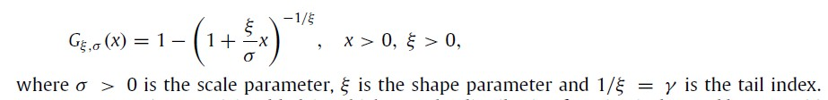


2.1 Generalized Pareto distribution
Distribution function:
Properties
1. Moment: $ξ>0,$heavy-tailed with $E[X^{k}]$ being infinite for $k>1/ξ$ ;
2. Stability:
if X is distributed $G_{ξ,σ}$, its excess loss is again $G_{ξ,σ+ξu}$.

Slide 6
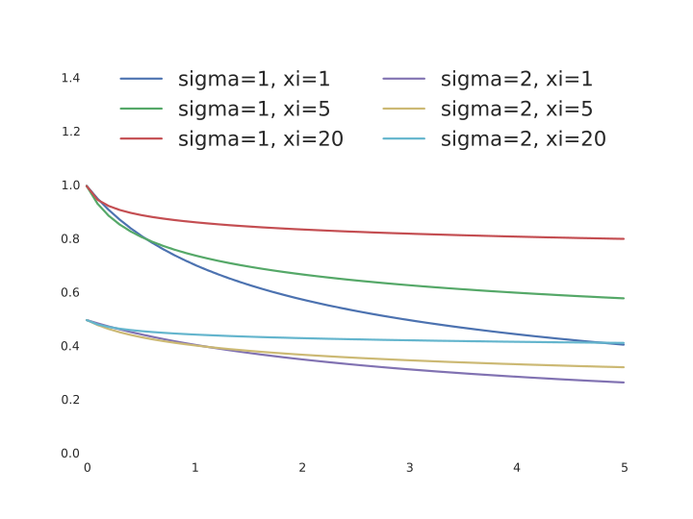
2.1 Generalized Pareto distribution

Slide 7

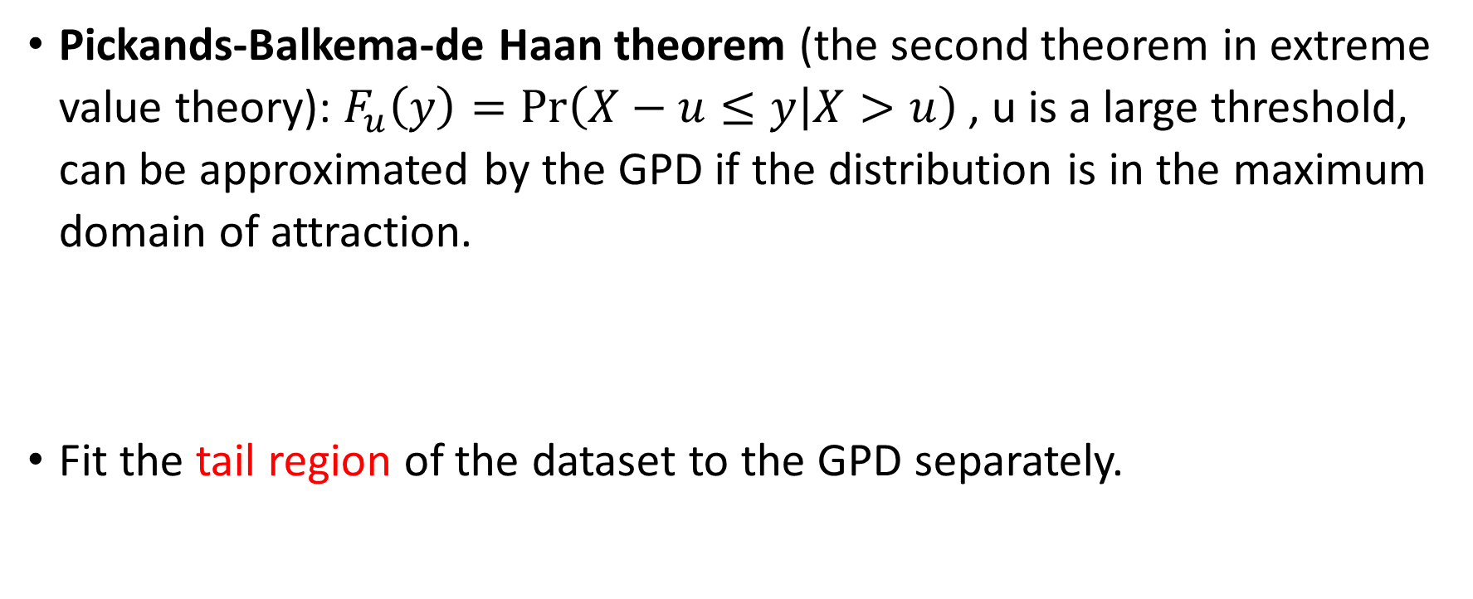
2.2 Peaks over threshold (POT)
Pickands-Balkema-de Haan theorem (the second theorem in extreme value theory): $F_{u}\left(y\right)=Pr\left(X−u≤y | X>u\right)$, u is a large threshold, can be approximated by the GPD if the distribution is in the maximum domain of attraction.
Fit the tail region of the dataset to the GPD separately.

Slide 8
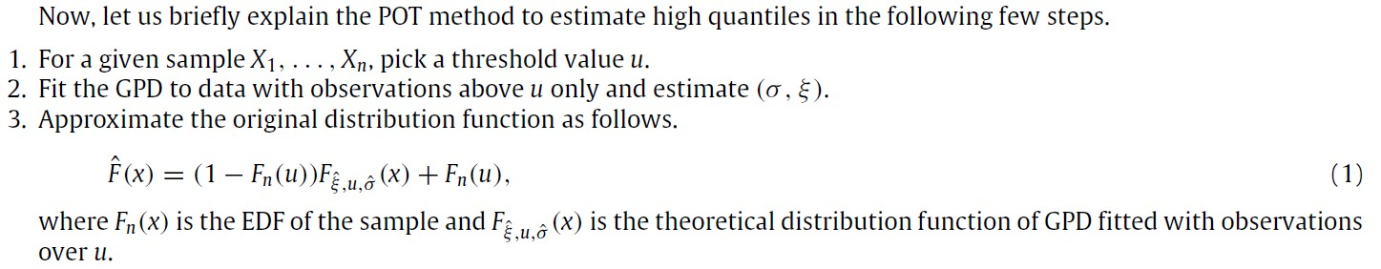
2.2 Peaks over threshold (POT)

Slide 9


2.3 Tail risk measures
Value-at-risk (VaR) of X at 100p% level is the 100p quantile of X:
Conditional Tail Expectation (CTE, coherent tail risk measure) or Tail VaR of X at 100p% level is:

Slide 10

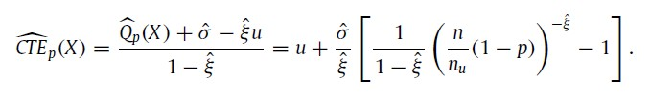
2.3 Tail risk measures
VaR estimate:
CTE estimate:
Highly sensitive to the estimated GPD parameters.

Slide 11



3. GPD estimation
Existing method : Song and Song (2012)
Step 1:
Step2:
Caveat: Minimizing the squared deviations between EDF and the theoretical GPD over x>u.

Slide 12
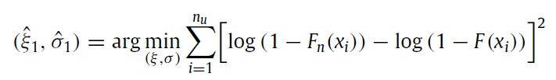
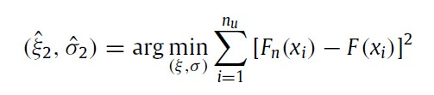

3. GPD estimation
New method :
Step 1:
Step2:
Step 2’:

Slide 13
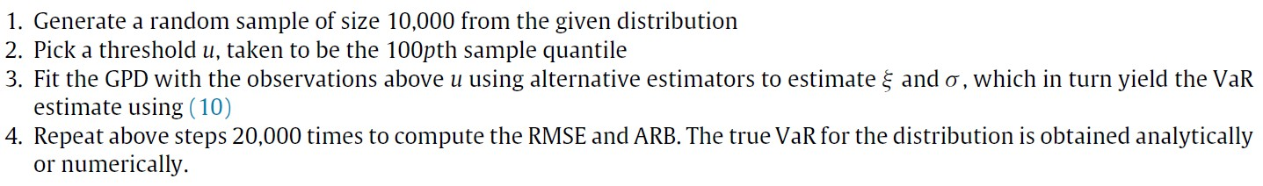
4. Simulation studies
VaR estimation
CTE estimation

Slide 14
Thank you!

